Slide 1
People Power for Public Health Webinar: August 30, 2022

Slide 2
Welcome and Housekeeping
Please share your name, pronouns, organization, and what brought you here today in the chat!
All sessions will be recorded and recordings, slides, and materials will be available after the event
Everyone is muted! There will be a Q&A at the end where folks can unmute and ask questions or drop them in the chat!

Slide 3
Why People Power for Public Health?
People Power for Public Health aims to reform budget processes and reallocate resources to address longstanding health inequities and chronic underinvestment in the public health infrastructure in communities of color.
COVID-19 racial and ethnic disparities in infections, hospitalizations, and deaths coupled with the murders of Breonna Taylor, George Floyd, Ahmaud Arbery, and many others helped to expose local budgets that prioritize law enforcement and criminal justice at the expense of public health and social determinants of health.
People Power for Public Health uplifts the theory of change that communities of color know exactly what they need to live in thriving and healthy neighborhoods and deserve the power to fund their own community solutions.
Notes:
Kiran

Slide 4
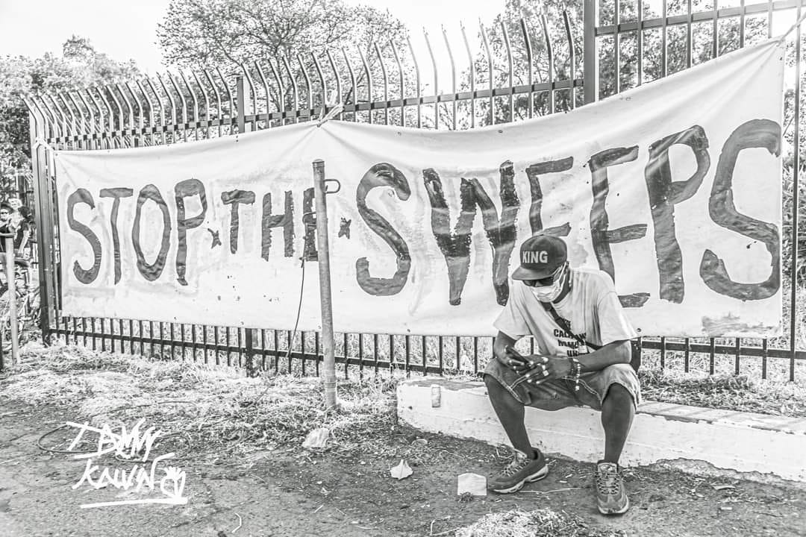
Research Questions
Desire-Based Framework: What Do We Want?
County Spending: What Do We Get?
Changing the Equation: Building Community Power
Notes:
Kiran

Slide 5
Methods
Notes:
Weiyu
Three-part research design
From September 2021 to January 2022, CPEHN fielded a statewide survey focused on people of color. The survey utilized an online platform and was conducted in English, Spanish, Traditional Chinese, Korean, Tagalog, and Vietnamese. Although the survey utilized a convenience sample, the responses offer key insights and testimonies around the experiences of people of color. Overall, the survey captured responses from 912 individuals.
County listening sessions included over 400 residents including specific focus on currently incarcerated, experiencing housing insecurity, Black residents, Latinx residents, community health workers, immigrants, Asian, Pacific Islander, and Native American residents.
Key informant interviews with community leaders, which helped us to understand how local power to transform local budgets has been built and mobilized.

Slide 6
Partners
Sacramento: Decarcerate Sacramento & Community Care First Coalition
Fresno: Central Valley Urban Institute
Kern: Visión y Compromiso
Orange: Multi-Ethnic Collaborative of Community Agencies (MECCA)
San Diego: Visión y Compromiso
Notes:
Weiyu

Slide 7
Desire-Based Framework: What Do We Want?

Slide 8
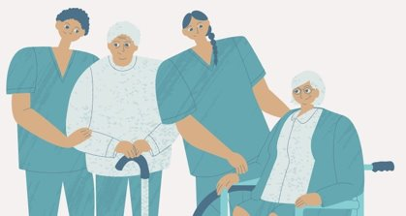
Create healthy community conditions
Ensure access to preventive, primary care
Transform the workforce to meet community needs
Strengthen emergency and crisis response systems
Notes:
Kiran
Increase Reliable Access to High Quality Primary, Preventive, and Behavioral Health Care. Despite significant gains in health insurance coverage since the implementation of the Affordable Care Act, a substantial number of Californians of color still lack health insurance coverage. Even participants with coverage highlighted the need to improve access to quality physical and behavioral health care.
Ensure Affordable and Accessible Emergency, Prehospital, and Mental Health Crisis Response Services. Many research participants reported using emergency and urgent care providers. However, participants described many barriers that prevent them from accessing needed emergency and prehospital services, including concerns about cost and insurance coverage and fear of law enforcement involvement.
Center Community-Connected and Culturally Responsive Care Workforce. Participants overwhelmingly wanted care that was culturally and gender responsive and linguistically appropriate, and access to providers that shared similar lived experiences. However, too few said that they had access to this needed workforce.
Prioritized Investment in Social Determinants of Health. Participants desired increased investment for social determinants of health such as affordable and quality housing, transportation, safety, parks and recreation, and healthy food availability.

Slide 9
Prioritize Investment in Social Determinants of Health and Healthy Communities.
Housing: Provide tenant relief and financial support for home ownership for historically excluded communities.
Community Safety: Fund community-based after-school and other youth programs, violence intervention and prevention, and trauma-informed services.
Food Access: Create opportunities for locally-grown food to stay local through subsidized farmer's markets, grocery stores, and school meals.
Green Space: Prioritize creation and maintenance of green spaces in each neighborhood.
"When I got to the park where I usually take [my daughter], the playground was burned down and melted... however the parks in the nice areas are farther away." - Kern County Resident

Slide 10
Increase Reliable Access to High Quality Primary, Preventive, and Behavioral Health Care.
Increase spending on primary care and prevention, including mobile clinics.
Integrate behavioral health care and develop behavioral health homes.
Fund community health education and navigation services.
Expand eligibility for coverage and simplify coverage transitions.
"I would like them to put more mobile clinics to check people without documents, those that don't have health insurance, and [clinics] that are free." - San Diego County Resident

Slide 11
Develop Community-Connected and Culturally Responsive Care Workforce.
Invest in workforce development programs such as:
Ensure fair wages for non-licensed health providers.
Develop advanced training programs for non-licensed health providers to specialize in their field.
Prioritize bilingual applicants for financial support for education and training.
Build the capacity of CBOs to employ health care providers with lived experience, to serve as health and behavioral health homes, and provide navigation services.
Remove barriers to licensing and certification based upon justice-involvement.
"I am so glad that a Spanish speaking outreach worker was able to help navigate our family through the COVID-19 vaccination process. Without them, I wouldn't know what to do." - Orange County Resident

Slide 12
Ensure Affordable and Accessible Emergency, Prehospital, and Mental Health Crisis Response Services.
Improve multi-sector collaboration to decrease the need for emergency services and improve follow-up navigation.
Expand emergency response system to include community-connected providers.
Improve the training of paramedics related to behavioral health and cultural humility.
Better regulate the cost and scope of ambulance services, mobile mental health crisis response, and urgent cares.
"When a family member was in mental crisis, we had called many agencies to get in-person mobile mental health crisis support but all they could do was call the police." - Survey Respondent

Slide 13
County Spending: What Do We Get?

Slide 14
Notes:
Weiyu
There are various taxes and revenue used to pay for health services and law enforcement. These funding sources are crucial to understanding net county costs and fluctuations in county budgets.
Most local decisions are made about how to spend county general fund dollars; other funding sources are often specifically directed by the state or federal governments. For example, the Mental Health Services Act provides XX billion each year which must be spent on mental health services for the local community.
County general fund dollars should be allocated in greater alignment with community priorities.

Slide 15
Sacramento County
Notes:
Weiyu
Our full brief shows the spending breakdown for 4 counties; today we will just discuss two.
IN the most recently adopted budget, Sacramento County allocated $383M for mental health and $117M for public health – a total of $500M.
At the same time, the County spent over $600M on the Sheriff's Department.
The disparity is much greater when looking at general fund expenditures only - $50M are allocated for mental and public health combined compared to $320M for the Sheriff's Dept.
This means that the County chooses spends per resident: $20 for mental health services, $12 for public health services, and $201 for law enforcement.

Slide 16
Orange County
Notes:
Weiyu
IN the most recently adopted budget, Orange County allocated $507M for mental health and $132M for public health – a total of $640M.
At the same time, the County spent nearly $900M on the Sheriff's Department.
The disparity is much greater when looking at general fund expenditures only - $10M are allocated for mental and public health combined compared to $227M for the Sheriff's Dept.
This means that the County chooses spends per resident: $2 for mental health services, $2 for public health services, and $72 for law enforcement.

Slide 17
Changing the Equation: Building Community Power

Slide 18
Findings
In our People Power survey, 74% of respondents said they are interested in creating or changing local policies.
Respondents shared that training on the policy making process was needed for them to get involved.
Communities and community-based organizations need to create opportunities for their residents to learn about and become engaged in local policy development and budgeting.
"I think we have to get involved more as a neighborhood and participate more in the decisions, because sadly it's a handful of people that decide where those resources go." - Kern County Resident

Slide 19
Contra Costa Budget Justice Coalition
Since their founding in 2017, they have focused on building out values-based local budgeting towards safe and affordable housing, essential health care, access to critical social services, and quality early care and education.
County Budgeting Education & Town Halls: The coalition has led town halls, hosted a budgeting 101 workshop, and developed stakeholder processes to ensure that community residents are involved in the budget making process.
Measure X: In 2020, the Coalition helped pass Measure X, a countywide general sales tax that would bring in $80 - $100 million a year to fund a system of prevention, care, and social and public services. The measure also included establishing a Measure X Community Advisory Board to develop an annual needs assessment to determine where tax dollars should be funded.

Slide 20
Presentation to California Pan-Ethnic Health Network
August 30, 2022
Dan Geiger
dan@budgetjusticecc.org

Slide 21
Contra Costa Budget Justice Coalition
Who we are
What we do
Goals, strategies
History and 2020-21 highlights
Looking forward

Slide 22
About Us
Our Mission
The Contra Costa Budget Justice Coalition advocates for community engagement in the Contra Costa County budgeting process and for a set of values-based budgeting principles that support safe and affordable housing, stable employment with fair wages, sufficient healthy food, essential health care, access to critical social services, quality early care and education.
WE BELIEVE that the primary purpose of a county budget is to be a social safety net. It should strive to reduce economic, racial and gender inequities, reduce barriers to success, promote healthy families, prioritize crime prevention over incarceration, and meet the needs of all residents, regardless of immigration status.

Slide 23
Membership – Advocacy, Human Services, Labor and Residents
Healthy Richmond/Local Initiatives Support Corporation
Human Services Alliance of Contra Costa
IFPTE Local 21
League of Women Voters Diablo Valley
Local Initiatives Support Corporation
Meals on Wheels Senior Outreach
Monument Impact
Multi-Faith Action Coalition
Planned Parenthood of Northern California
Racial Justice Coalition
Richmond Community Foundation
Richmond LAND
Rubicon Programs
Safe Return Project
SEIU Local 1021
SURG Contra Costa
United Latino Voices
And many residents of Contra Costa
350 Contra Costa
AFSCME Local 2700
Alliance of Californians for Community Empowerment (ACCE) Contra Costa
Asian Pacific Environmental Network
Bay Area Community Resources
Choice in Aging
Community Clinics Consortium
Contra Costa Labor Council
Contra Costa Office of Education
East Bay Alliance for a Sustainable Economy
East Contra Costa Community Alliance
Ensuring Opportunity
First 5 Contra Costa/Family Economic Security Partnership
Food Bank of Contra Costa
Great Richmond Interfaith Program

Slide 24
Our Work
Educate
Analyze
Activate
Advocate

Slide 25
Goals and Strategies
High Level Goals
Transform county culture around budgeting
Establish a values-based budgeting process and equity priorities
Increase transparency and community engagement in budgeting
Educate community stakeholders on budget and budget advocacy
Strategies
Build coalition of labor, human service, advocacy orgs, residents
Research and analysis
Hold County accountable on budget deliberations and decisions
Develop and advocate process and transparency proposals
Various educational programs
Cultivate relationships with BoS, CAO, department heads
Issue advocacy
Mobilize members

Slide 26
History & Highlights
WE ARE A FORCE TO BE RECKONED WITH!
2017
Small group meets
How can we bring stronger community voice to the County's budgeting process?
2018
Launch – survey gets 400+ responses
Educate ourselves
Research
Process proposals
Issue advocacy
2019
Town halls with Supervisors
Ongoing process and issue advocacy
Begin advocacy for sales tax ballot measure
2020
COVID, COVID, COVID
Measure X on ballot
Racial Justice and Social Equity
Equity Presentation to Board of Supervisors
2021
ARPA
Measure X Advisory Board
Reimagine Public Safety
Budget Town Halls
Bay Area Equity Atlas
2022
Equity Presentation at Budget Retreat
Town Hall with Departments
Budget Analysis/ARPA advocacy
Partnering with Office of Racial Equity and Social Justice
Supervisor Candidate Budget Questionnaire

Slide 27
Moving Forward – Plans for 2022-23

Slide 28
A Staged 3-Pronged Approach
Embed Equity Principles in Departmental Budgeting
Build Momentum towards a People's Budget
Participatory Budgeting Project with ORESJ
Ongoing advocacy, supported by community education, engagement, and partnership

Slide 29
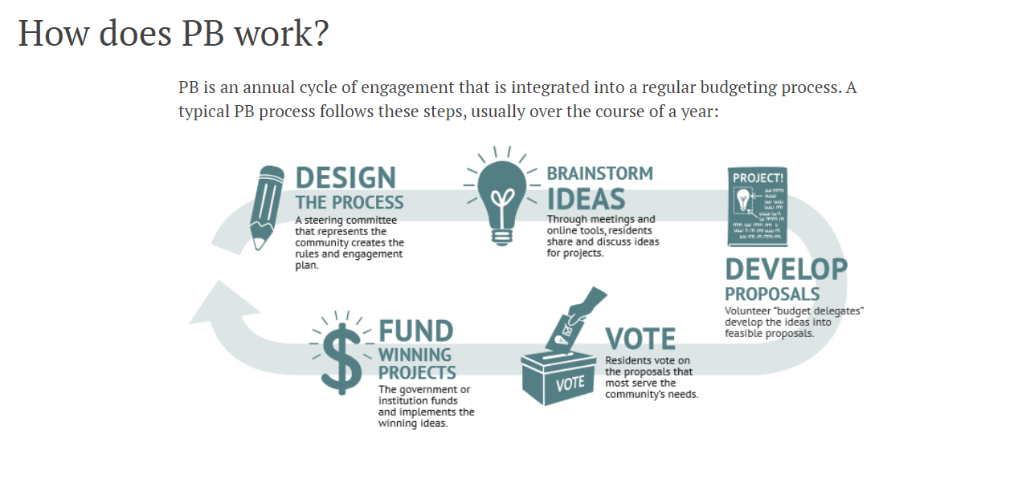
Participatory Budgeting Participatory budgeting (PB) is a democratic process in which community members decide how to spend part of a public budget. It gives people real power over real money

Slide 30
PARTICIPATORY BUDGETING Benefits and Impacts
Increased civic engagement
Stronger relationships between residents, government, and community organizations
Broader political participation, especially from historically marginalized communities
More equitable and effective spending.
New community leaders.

Slide 31
These efforts build momentum towards a larger People’s Budget that would address the entire County Budget

Slide 32
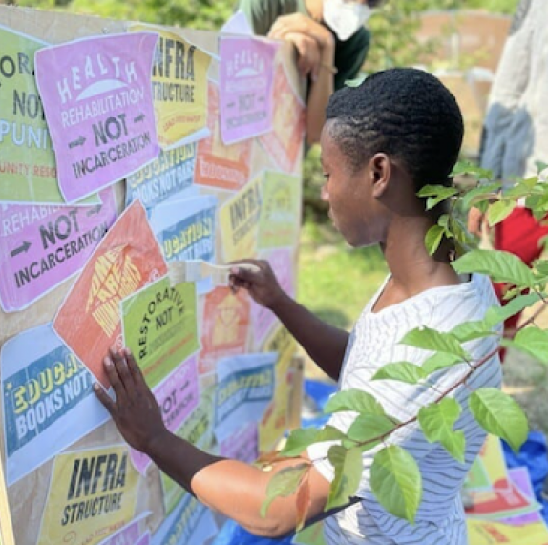
A People’s Budget
A People’s Budget is an interactive way to center civic engagement as a core emphasis in the budget process and which is structured in a more meaningful way to learn about how government works and how it spends money.

Slide 33
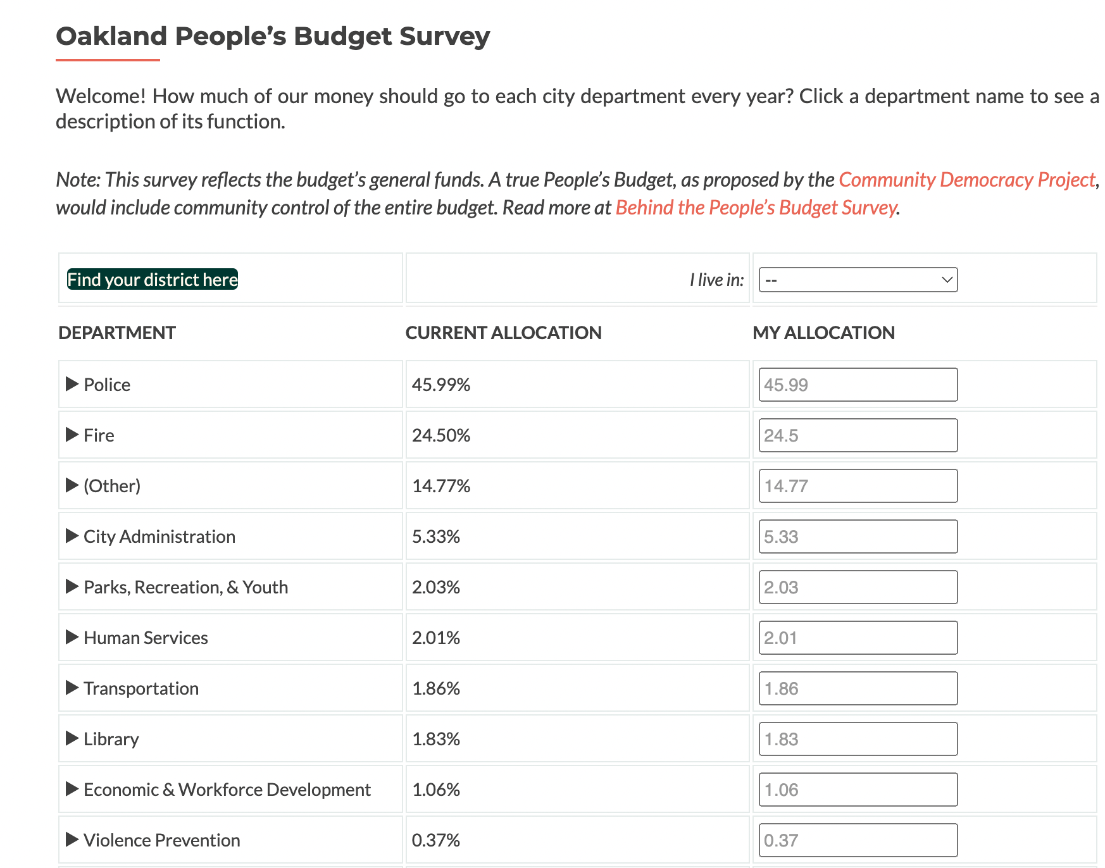
Towards a People’s Budget in Contra Costa
Would apply to the entire County Budget
Challenges
We have more to learn; want to do it right
A significant undertaking; resources needed
It will take time to develop and utilize it as an advocacy tool
Start small and learn
Get the ball rolling with a community survey, modeled after the Oakland People’s Budget
Can help frame FY 23-24 budget advocacy

Slide 34
QUESTIONS?

Slide 35
Get Involved!
If you'd like to learn more about our public health and local budget work, please contact Weiyu Zhang at wzhang@cpehn.org

